Slide 1




JORC 2012 Code Review
Progress Update
AUSTRALASIAN JOINT ORE RESERVES COMMITTEE
Southern Queensland Branch AusIMM Brisbane
19 April 2023

Slide 2
AUSTRALASIAN JOINT ORE RESERVES COMMITTEE
JORC was established in 1971 and is sponsored by the Australasian mining industry and its professional organisations. JORC is a member of and works closely with CRIRSCO, the Committee for Mineral Reserves International Reporting Standards.
JORC comprises representatives of each of the three parent bodies:
    The Minerals Council of Australia (MCA)
    The Australasian Institute of Mining and Metallurgy (The AusIMM)
    The Australian Institute of Geoscientists (AIG)
As well as representatives of the Australian Securities Exchange (ASX), the Financial Services Institute of Australasia (FinSIA) and the accounting profession, and an observer from the Association of Mining and Exploration Companies (AMEC).
Parent Bodies | JORC | ASIC | Technical Professional Consultant / Advisor Investor / Potential Investor Company Executive Non-executive directors Public/Investor Relations Banking and Finance Legal Analysts Media ESG Professional
 |  | ASX
 |  | CRIRSCO FinSIA Mines Departments Government Agencies International Societies AMEC NGO
AusIMM
MCA
AIG

Slide 3
AUSTRALASIAN JOINT ORE RESERVES COMMITTEE
JORC | Member | Affiliation/Representing | Professional Background
JORC Exec | Steve Hunt, Chair | MCA | Geologist
 | Peter Stoker, Deputy Chair | AusIMM | Geologist
 | Graham Jeffress | AIG | Geologist
 | Jillian Terry | MCA | Geologist
JORC Committee | Chris Cairns | AIG | Geologist
 | Andrew Hall | AusIMM | Engineer
 | Tracie Burrows | AIG | Geologist
 | Lynn Olssen | AusIMM | Geologist
 | Dean David | AusIMM | Metallurgist
 | Kevin Gleeson | MCA | Geologist
 | Jared Broome | MCA | Geologist
 | Adam Myers | Accounting Profession | Chartered Accountant
 | James Rowe | ASX | Lawyer
 | Chris Brown | FinSIA | Geologist / Economist
 | Michael Slifirski | FinSIA | Mining Engineer/Metals & Mining Equity Analyst
 | Vacant | Accounting Profession | -
 | Neil van Drunen | AMEC | Economist
 | Ann Ledwidge | AIG | Geologist
Ex-officio members | Shane Evans | MCA | Economist
 | Rene Sterk | AusIMM | Geologist
 | Rod Carlson | AIG | Geologist

Slide 4



THE JORC CODE
The Australasian Code for Reporting of Exploration Results, Mineral Resources and Ore Reserves ('the JORC Code') is a professional code of practice that sets minimum standards for Public Reporting of Exploration Results, Mineral Resources and Ore Reserves.
The JORC Code is produced by the Australasian Joint Ore Reserves Committee ('JORC').
JORC has resolved to undertake a detailed review of the Code provisions and procedures, to maintain professional standards and to satisfy the ongoing governance requirements of the ASX and ASIC.
The JORC Code provides a mandatory system for the classification of Exploration Results, Mineral Resources and Ore Reserves according to the levels of confidence in geological knowledge and technical and economic considerations in Public Reports.
Public Reports prepared in accordance with the JORC Code are reports prepared for the purpose of informing investors or potential investors and their advisors.
Public reporting in accordance with the Code requires the formal signoff of a Competent Person, who is a mining professional meeting specific qualification, experience, and professional membership requirements.

Slide 5
THE REVIEW PROCESS
2020
2021
2022
2023
PRELIMINARY ENGAGEMENT
AND IDENTIFICATION OF KEY ISSUES
TARGETED ENGAGEMENT
AND WORKING GROUPS
DRAFT OPTIONS AND REVIEW
DRAFT UPDATED CODE, CONSULTATION AND APPROVALS
Stakeholder engagement and consultation activities have included general feedback provided directly and indirectly via emails, meetings, and online survey with submissions from individuals, industry bodies, companies, and organisations.
A series of Working Groups (WG) were formed to review issues / opportunities raised from the online survey results, industry bodies and other organisational feedback
Draft options of changes to the Code, including:
Options of proposed changes to current wording of the Code
Options for inclusion of proposed new sections or clauses to the Code
Will be circulated to key stakeholders for review and feedback.
A draft interim updated JORC Code will has been prepared for review by ASX and ASIC. Followed by Parent Body and all stakeholder consultation and feedback.
A final draft Code will be prepared for approval by Parent Bodies, then ASX for recommendation to ASIC for Ministerial approval.

Slide 6

THE REVIEW PROCESS - ENGAGEMENT
General Engagement
ASIC and ASX
Online Survey
Summary of Key Issues
Code Review
Competent Person Review
Direct Consultation
Working Groups
JORC
JORC
Joint Taskforce
Parent Bodies / JORC
Draft Options (JORC Code)
including proposed changes to current wording and drafting of new sections of the Code
ASIC and ASX review and feedback
CRIRSCO consultation and feedback
Pending Parent Body approval
Draft Options (JORC Code)
including proposed changes to current wording and drafting of new sections of the Code
Draft Options (Competent Person)
including proposed changes to relevant sections of the Code
Draft Update JORC Code
including all proposed changes, additions and options

Slide 7
STAKEHOLDER SURVEY
The online survey was open to all stakeholders during December 2020 to April 2021.
A total of >500 survey submissions were received with submissions from individuals, industry bodies, companies, and organisations.
Primary Background
Survey analytics conducted included response grouping and ranking by priority areas based on a combination of factors including number of respondents, detail of responses, similarity or opposition of opinion and potential future implications and considerations.

Slide 8
RESPONDENT EXPERIENCE
The survey highlighted the extensive experience held by most respondents, with over 370 respondents (73%) having more than 20 years’ minerals industry experience, and comparably this group responded as having the most exposure to the Code.
Minerals Industry Experience
Exposure to the Code

Slide 9
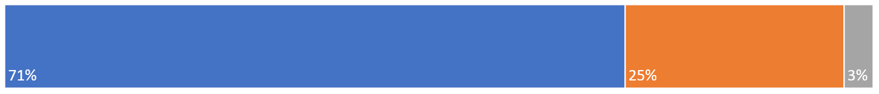
UNDERSTANDING OF THE CODE
Survey response indicates that 71% of respondents felt the overall principles of the code were simple to understand, 25% were neutral on the topic and approximately 3% indicated they found understanding the Principles of the Code difficult.
Overall understanding of the Code
SIMPLE
NEUTRAL
DIFFICULT
Understanding the Principles of the Code
The majority of respondents indicated each principle was simple to understand, however approximately 9% indicated Materiality was difficult, and approximately 12% that the principle of Competence was difficult.

Slide 10
REASONS FOR USING THE CODE
Respondents were asked to select all applicable reasons for using the code. Results demonstrate that the top three reasons for using the Code relate to preparation of Competent Person’s reports, reporting of Mineral Resources and/or Ore Reserves and for preparing expert reports. This was followed by market related reasons, with 19% related to preparation and understanding of market releases and reports. Company annual and continuous disclosure returned 12% of responses.

Slide 11
CODES APPLIED
Results show that approximately 34% of respondents have applied the Canadian Institute of Mining Metallurgy and Petroleum (CIM) National Instrument 43-101(NI 43-101). Approximately 17% respondents have applied the VALMIN code and approximately 10% have applied other codes, standards and guidelines based on the CRIRSCO template.

Slide 12
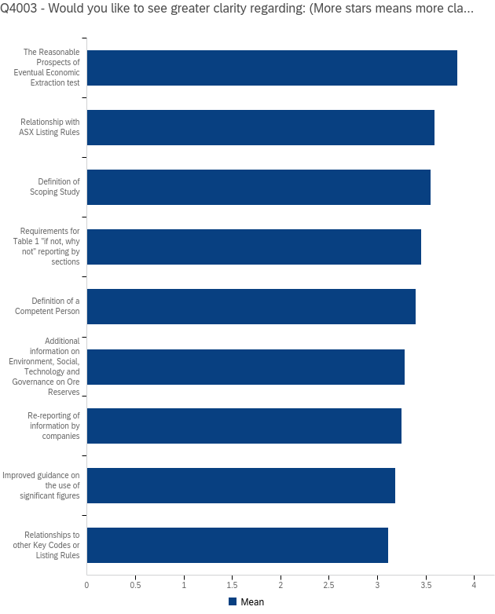
KEY AREAS FOR REVIEW
The survey asked respondents to indicate which areas of the Code they would like to see greater clarity regarding.
Mean results suggest respondents would like greater clarity concerning several areas including;
The Reasonable Prospects of Eventual Economic Extraction test (RPEEE)
Definition of a Competent Person
Additional information on Environment, Social, Technology and Governance on Ore Reserves.

Slide 13
KEY AREAS REVIEWED – WORKING GROUPS
Competent Person
Reasonable Prospects (RPEEE)
Environmental, Social, Governance (ESG)
Working Groups
Reporting of Risks
A series of Working Groups formed to address key issues identified.
Each Working Group:
provided input into the development of the JORC Code review.
Provided thoughts, options, and assistance in the review of the Code, specifically around the key area.
Reconciliation performance
Guidance notes
Use of JORC Code for non reporting purposes
Relationship to ASX Listing Rules and/or to other codes
Other Issues

Slide 14




COMPETENCE & COMPETENT PERSON
AusIMM & AIG have formed a Joint Taskforce to review options for improving the requirements to act as a Competent Person
Scope to move from self-nomination to a more robust process
Competence verification and/or accreditation processes
Disciplinary process, enforceability and transparency
Senior Competent Person and subsidiary technical specialist signoff model incorporated into code draft.
Working Groups

Slide 15



COMPETENT PERSON BASELINE STUDY
Study Review Process
Baseline Study Draft
Author compilation
Baseline Study
Peer review
JORC
Competent Person
Working Group review
June- August
Lead Author Recommendations
Joint Taskforce
review
August
Working Group
Recommendations
Parent Body Recommendations for change
Joint Taskforce
Public consultation
JORC Code update
Late 2022/23
Recommendations from the Baseline Study, essentially a factual background, related to definition of a Competent Person, Competent Person consent forms and potential membership requirements also considered

Slide 16




ESG
JORC Working Group completed a review of 90+ available ESG references, guides, frameworks and developed a series of options for consideration
New clause under review
Integrated approach of ESG disclosure within Table 1 reporting requirements
Balanced reporting across all the modifying factors, including ESG
Guidance matrix for practitioners
Working Groups
Use of JORC Code for non reporting purposes
Not inventing new ESG reporting systems

Slide 17


RISK: OPPORTUNITIES AND THREATS
JORC Working Group formed to review options for greater visibility of opportunities and threats reporting within the Code:
Requirement for the Competent Person to disclose material opportunities and threats for Exploration Targets, Mineral Resources and Ore Reserves
Options for a new table or section within Table 1 outlining disclosure criteria
Working Groups
Use of JORC Code for non reporting purposes

Slide 18
RECONCILIATION
It was recognised that the current Code was lacking in requirement to report reconciliation performance
New clause recommended requiring disclosure of comparison of an estimate to a estimate, such as a Mineral Resource and/or an Ore Reserve, or alternatively, the reconciliation of the mined part of an estimate to the mine production results
External guidance recommended to improve understanding and reporting in this area
Working Groups
Working Groups

Slide 19



JORC CODE GUIDANCE
The JORC Survey and other stakeholder feedback highlighted need for greater guidance across several areas of the Code, options to consider include:
Re-structuring of the code in a manner analogous to the ASX LR, GN and other supporting material
The need for Investor and practitioner tailored guidance with links to relevant ASIC, ASX guidance notes, FAQs, and other references
Requirement to better define studies (including scoping studies), and alignment of terms
Additional principles-based external guidance with worked examples and links to papers or references. Commodity guidance layers move external to code
Potential adoption of CRIRSCO Template Table 1 and Table 2 format allowing guidance by project development stage: Exploration, Resource and Reserve
Working Groups
Use of JORC Code for non reporting purposes

Slide 20
JORC would like to thank the volunteers for their time and expertise in the Code Review Working Groups
Andre Badenhorst | Geraldine McGuire | Kirsty Sheerin
Andrew Pocock | Godknows NJowa | Leslie M Watson
Beau Nicholls | Gregory MacDonald | Marco Orunesu Preiata
Bridget Alldridge | Harald Muller | Marcus Reston
Bruce Harvey | Heath Arvidson | Mark Adams
Bruce Sommerville | Ian Glacken | Mark Berry
Chris Davis | Ian Ritchie | Mark Murphy
Clint Ward | Ioannis Kapageridis | Peter Fairfield
Craig Morley | Ivy Chen | Rebecca Jackson
Deborah Lord | Jacinta Ireland | Sam Ulrich
Douglas Corley | Jeremy Peters | Selina Zoe Broun
Dr Paul Weber | John A. Rusnak | Shauna Martin
Emily Harris | Jon Crosbie | Tatum Woodroffe
Gabrielle Kirk | Jonathan Moore | Timothy O'Sullivan
Geoffrey Booth | Jonathon Trewartha | Todd McCracken
:

Slide 21
NEXT STEPS - STAKEHOLDER ENGAGEMENT
ASIC and ASX review of draft -underway
CRIRSCO
Parent Bodies (AusIMM, AIG, MCA)
Working Group members (technical review)
Industry
Public

Slide 22








PROJECT PLAN – PROGRESS
JUNE2021
JULY-DEC
2021
Q4
2021
2020
Engagement and Online Survey
Release of Summary of Key Issues and Work Plan
Working Groups and targeted engagement
Draft JORC Code options and review
Q2 2022
-Q2 2023
Late 2023
TBC
TBC
Draft updated JORC Code and review
Final Draft
Approval Process
JORC 2023 Code release

Slide 23


STAY INFORMED
Code Update Contact:
Project Manager – JORC Review
jorc@ausimm.com.au
http://www.jorc.org
https://www.linkedin.com/company/australasian-joint-ore-reserves-committee

